Slide 1

Introduction to Move
Objectives:
Build smart contracts on Sui with strong foundations and patterns
Learn Move language and the unique Sui object-centric model

Slide 2
Agenda
What is Move?
Toolchain & Environment Setup
Variables, Data Types, and Mutability
Sui’s Smart Contract Patterns
Capabilities in Sui
Error Handling and Security Practices

Slide 3
Learning Objectives
Key takeaways: Move ensures safety, Sui’s object model and capabilities enable advanced patterns.
Explore resources and exercises for deeper learning.
Sui Developer Portal for further resources. (https://sui.io/developers)

Slide 4
What is Move?
Safe & Flexible
Resource-oriented
Move is designed for secure and adaptable smart contracts on Sui.
It manages assets safely, preventing common vulnerabilities like reentrancy.
Sui Usage
Move controls on-chain objects, ensuring efficient and secure data management.

Slide 5

Toolchain & Environment Setup
Install Sui CLI
Ensure scarcity and prevent duplication of digital assets.
Initialize a new package
sui move new <project>

Slide 6
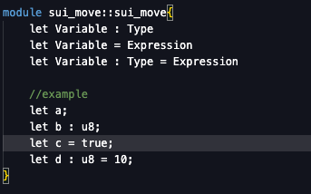
Variables, Data Types, and Mutability
Ownership model
Variables follow Rust-like ownership rules for memory safety.
Data types
bool: true/false
u8, u64: unsigned integers
address: account identifiers
vector: dynamic arrays
Mutability
(https://move-book.com/reference/primitive-types)
let creates immutable variables, let mut makes them mutable.

Slide 7
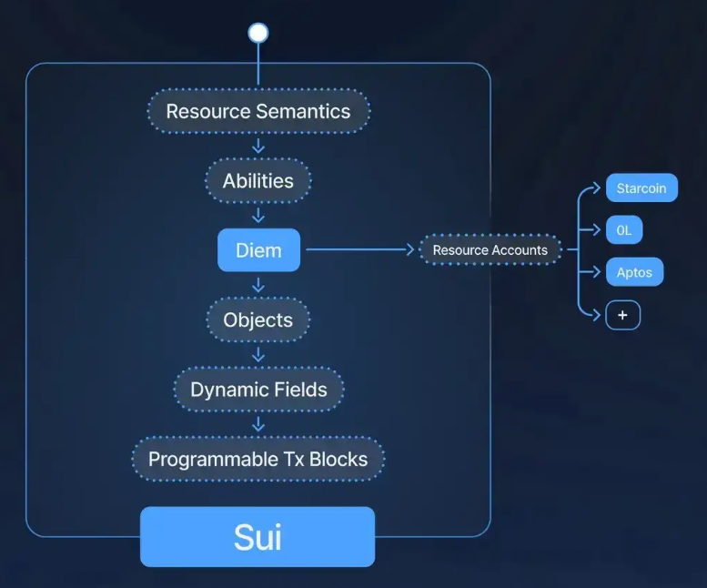
Resources and Objects
Resources
Ensure scarcity and prevent duplication of digital assets.
Objects
Sui's core data structures; can be owned, shared, or immutable.
Ownerships
Wrapping enforces single ownership to avoid unauthorized copies.
Transfer
Use transfer::transfer to safely move object ownership.

Slide 8
Models and Functions
Modules
Functions
Visibility
Example
Contain code defining structs and functions for organization.
Serve as entry points implementing on-chain business logic.
Public: accessible within modules
Private: restricted access
Entry: callable from transactions
A module creating and managing fungible tokens on Sui.

Slide 9
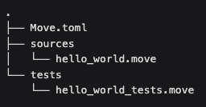
Basic Structure of a Move Project
Move.toml
The main configuration file of the project
Contains information about the project name, dependencies, and published addresses
Similiar to package.json in NodeJS or Cargo.toml in Rust
sources/
Directory containing the main source code of the project
.move files contain smart contract code
Each Move module is defined in a separate file
tests/
Directory containing test files
Test files usually have the suffix _test.move.
Used to write unit tests for smart contracts

Slide 10
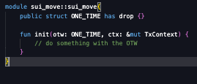
Common Design Patterns
Data as objects
Capabilities in Sui
Sui’s model stores data as objects (owned or shared)
Capabilities control access, ensuring only authorized actions
One-time Witness Pattern
Ensures an action can only be performed once by a uniquely created object as proof.

Slide 11
Security Considerations
Gas Optimization
Reentrancy Prevention
Formal Verification
Minimize costs to avoid denial-of-service from expensive transactions.
Resource model helps block reentrancy attacks efficiently.
Mathematically prove critical contract logic correctness.

Slide 12
Practical Exercises
Sui Documentation: Writing Your First Smart Contract for guidance. (https://docs.sui.io/guides/developer/writing-your-first-smart-contract)
Build a smart contract: creating a token, transferring ownership, managing resources with capabilities.

Slide 13
Thank You.

